Slide 1

Web application on fertilizer management system
Under the Guidance
Mr. v. raju
Associate professor
BATCH-2
SCHOOL OF ENGINEERINg
Department of Computer Science and Engineering
NALLA NARASIMHA REDDY
EDUCATION SOCIETY’S GROUP OF INSTITUTIONS
Chowdariguda(VIII) Korremula ’x’ roads, via Narapally, Ghatkesar(Mandal)
Medchal(Dist),Telangana-500088
2021
SUBMITTED BY
Y.RUCHITHA 177Z1A05A2
P.BINDU BHARGAVI 177Z1A0578
S.AKHILA 177Z1A0595

Slide 2
ABSTRACT
Agriculture is very important thing for everyone. Farmers counting are reduced day by day, so that automation is implemented in agriculture. In farming process have a lot of work like a planting, watering, fertilizing, etc
Organic fertilizers is very long term process and very costly compared to chemical fertilizers. Some fields require only certain chemicals or minerals but where as in fertilizers and organic manure they contain various type of minerals and unwanted minerals may spoil the crop
Supply of manure in INDIA has 3 major key factors they are government policies , accessibility of water , advertisement.
The main aim of this project is to show particular fertilizers used for particular crop.

Slide 3
EXISTING SYSTEM:
The existing framework it is totally a manual process and during this manual process there is more tendency of doing mistakes in choosing fertilizers.
In existing system farmers cannot get required information of fertilizers used for their crop because of retail sellers.

Slide 4
DISADVANTAGES
There are few dis-advantages identified in the existing system and are defined below:
High chances to get cheated
No exact information
Time consummation
No information regarding new fertilizers

Slide 5
PROPOSED SYSTEM
In this application cultivators can have information regarding the fertilizer such as cost of each fertilizer and what kind of fertilizer to use for a particular crop.
we can over come major loop likes high chances to get cheated no exact information , time consummation , no information regarding new fertilizers . By this system there will be more advantage to cultivation group.

Slide 6
ADVANTAGES
There are advantages in the proposed system which could overcome the drawbacks of the existing system and are defined below:
Less human error
Strength and strain can be reduced
High security
Easy to handle
Easy to know cost of fertilizers
Easy record keeping of new fertilizers

Slide 7
Software Requirements:
The software requirements that are required for this project are as follows:
Operating System : Windows 7/8/10
Php
Html
Java script

Slide 8
Hardware Requirements:
The most common set of requirements defined by any operating system or software application is the physical computer resources, also known as hardware, a hardware requirements list is often accompanied by a hardware compatibility list(HCL), especially in case of operating system.
The hardware requirements that are required for this project are as follows:
Sd card
Sim card
Ram-4gb

Slide 9
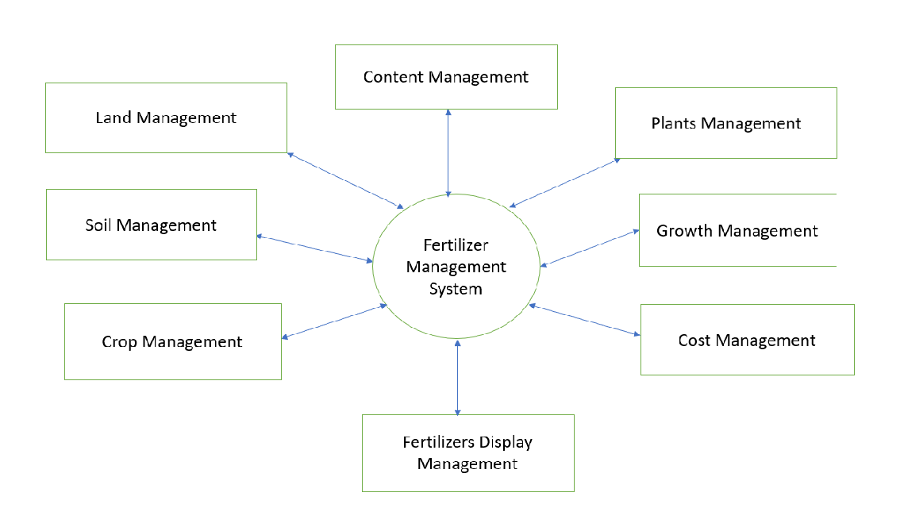
block diagrams:

Slide 10
Modules : t
There are two types of modules :
1. Structural Module
2. Deployment module
STRUCTURAL MODULE :
Structural model represents the frameworks for the system and this framework is the place where all other components exist.
The Structural model never describes the dynamic Behaviour of the system.
It consist of following UML diagrams:
1. Class Diagram
2. Deployment Diagram

Slide 11
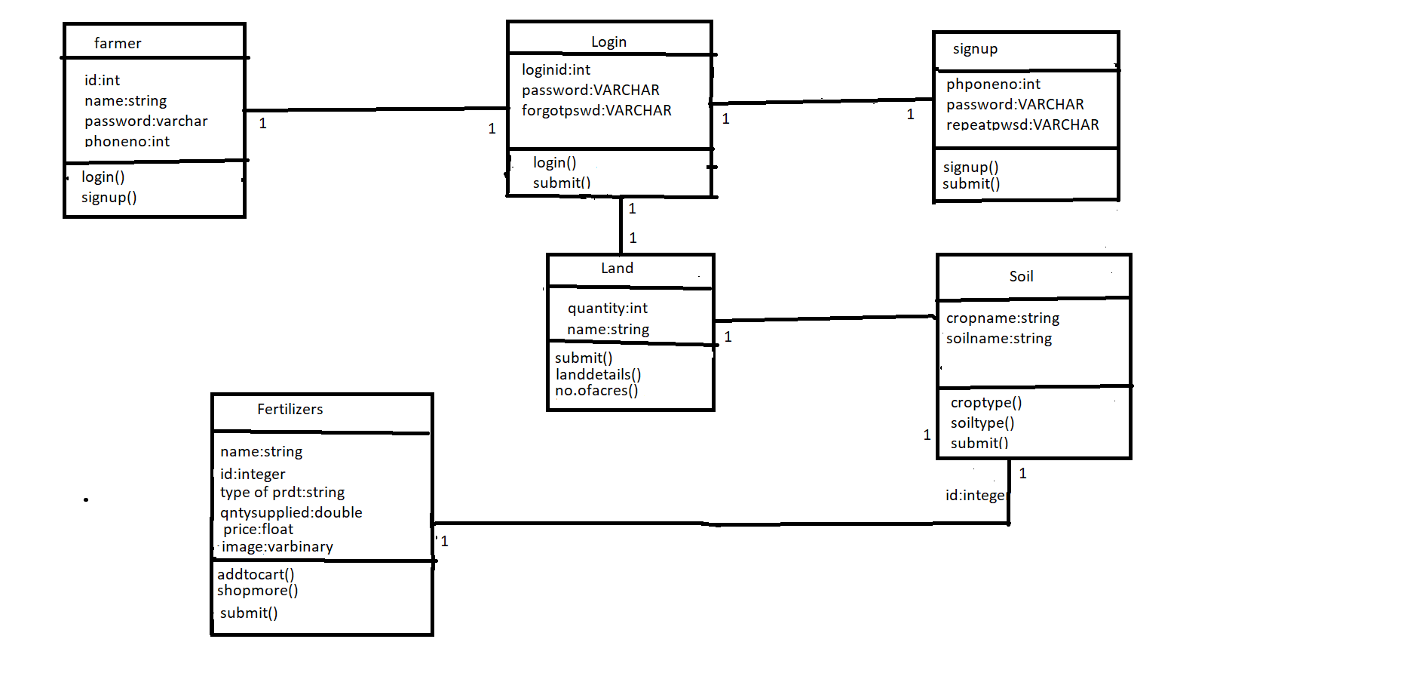
CLASS DIAGRAM :

Slide 12
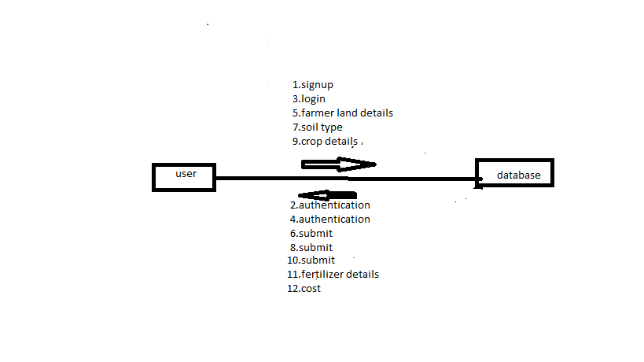
DEPLOYMENT DIAGRAM :

Slide 13
BEHAVIOUR DIAGRAM :
Behavioural model describes the interaction in the system. It represents the interaction among the structural diagrams. Behavioural modelling shows the dynamic nature of the system.
They consist of the following:
Use case diagram
Sequence diagram

Slide 14
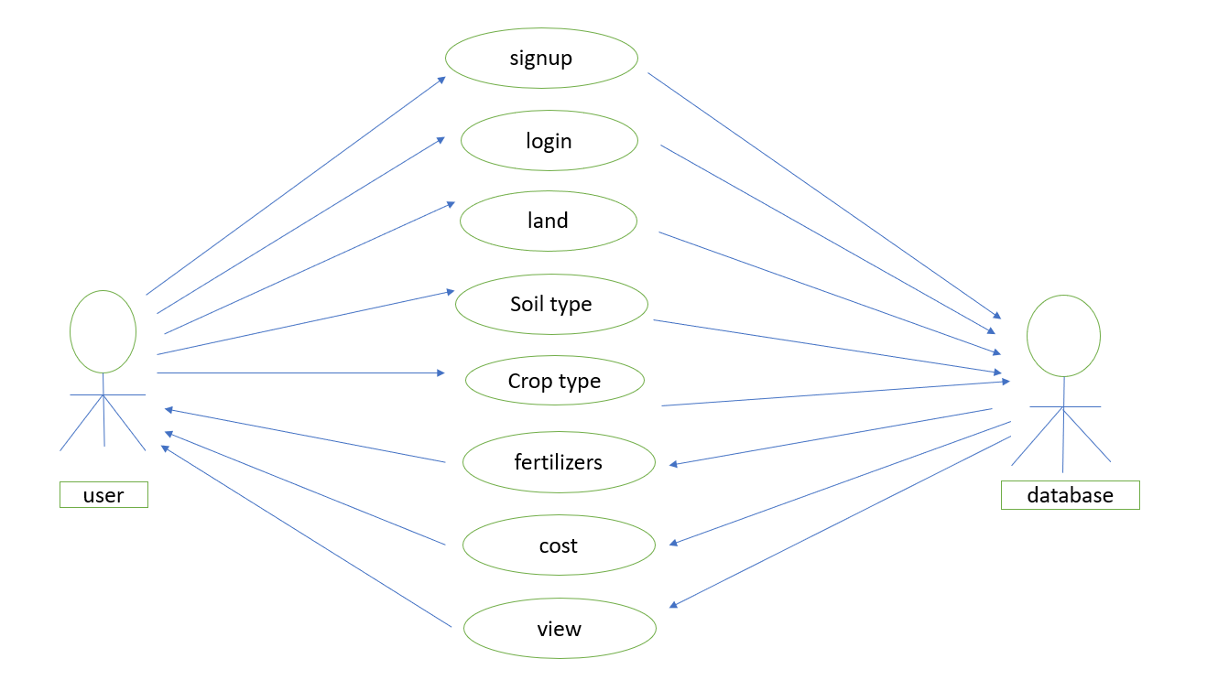
USECASE DIAGRAMS:

Slide 15
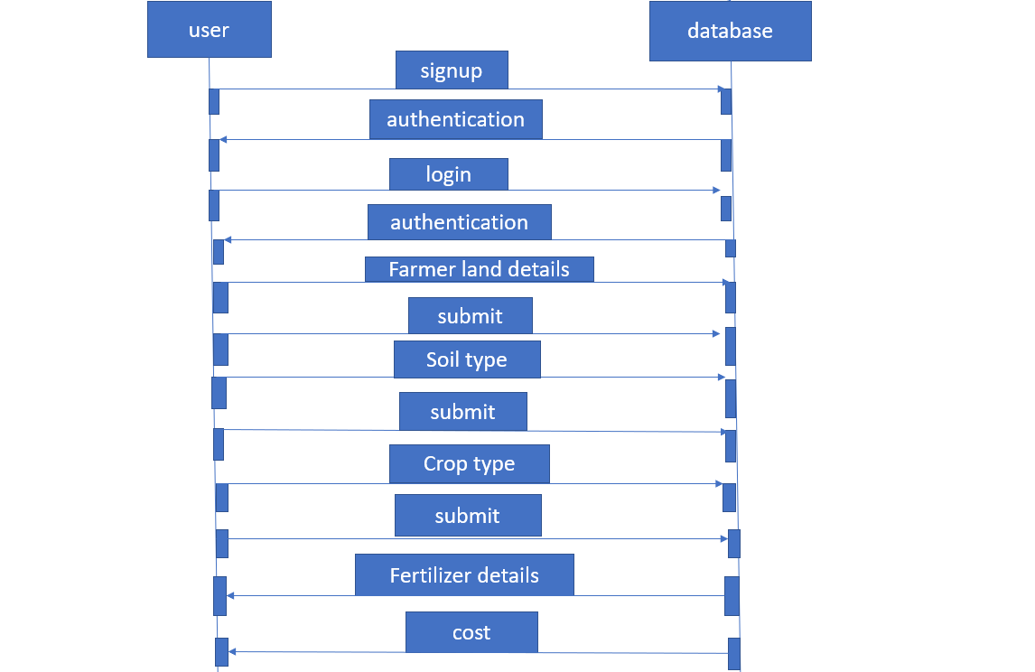
SEQUENCE DIAGRAM :

Slide 16
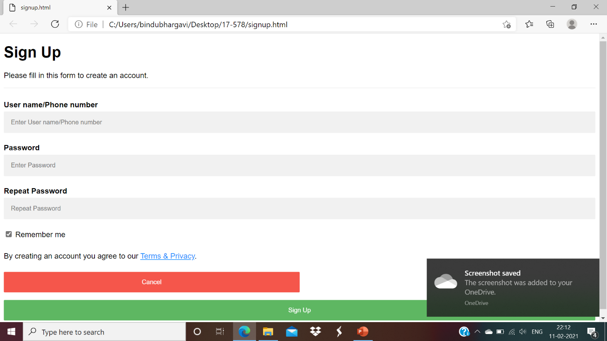
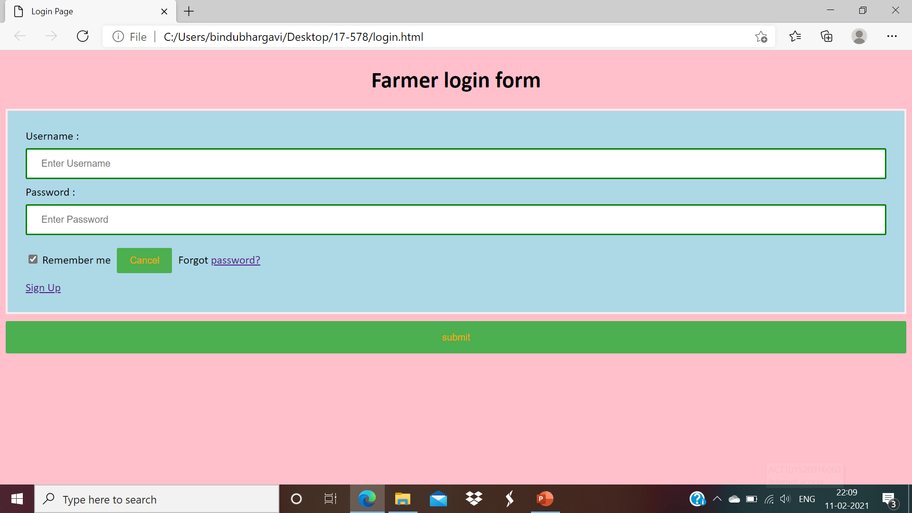
Snap shots : Login & signup forms :

Slide 17
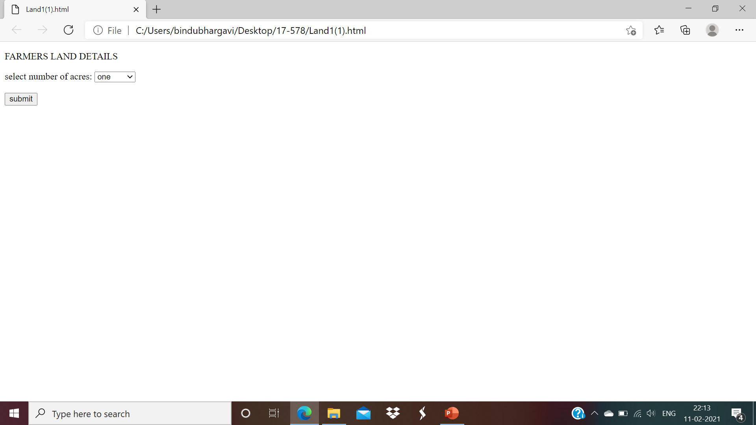
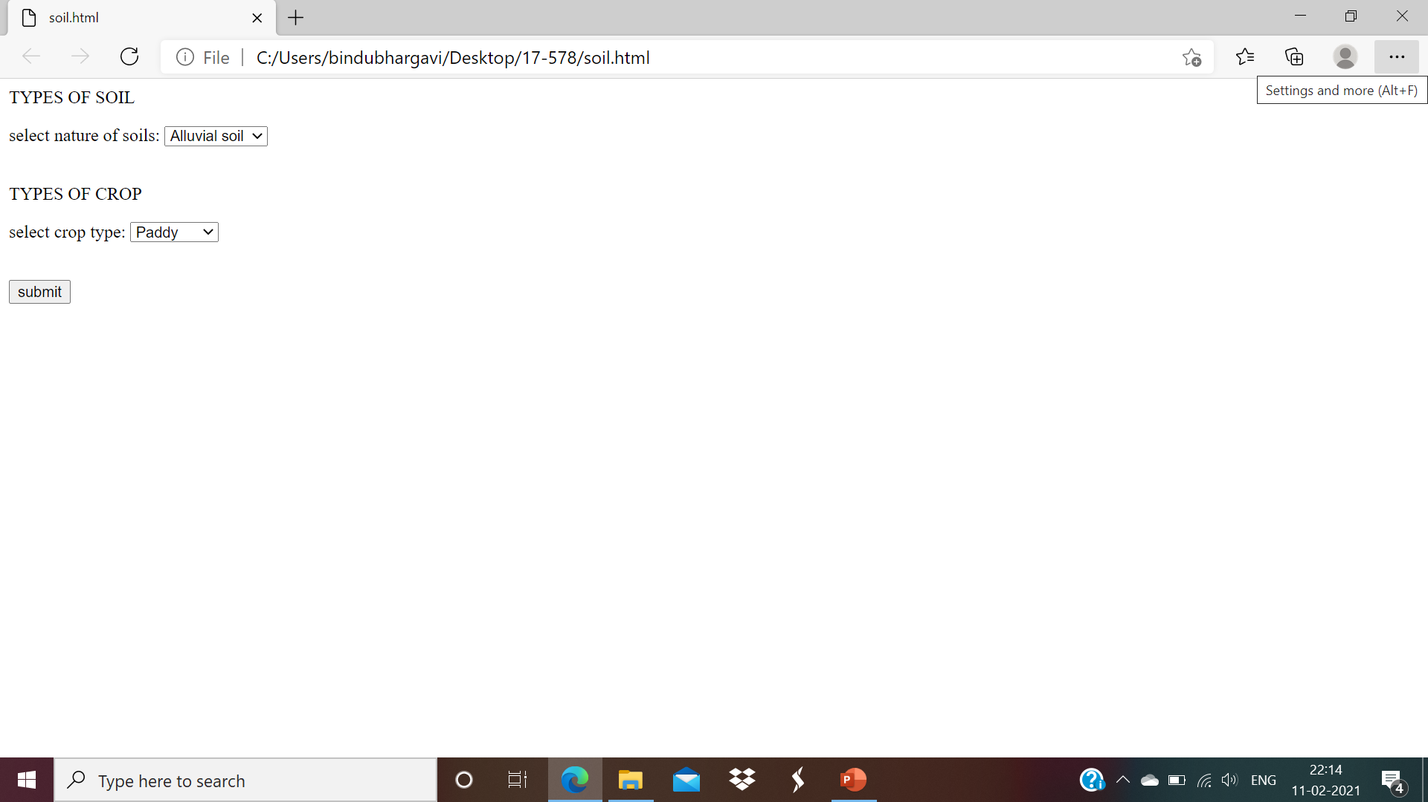
Land & soil typeS:

Slide 18
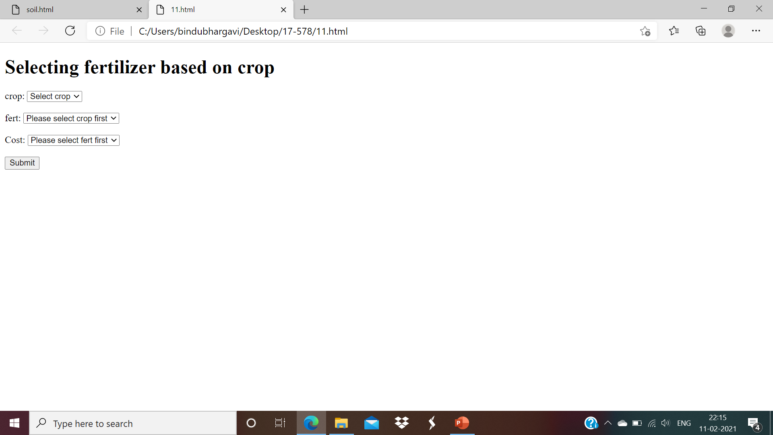
Selecting fertilizers :

Slide 19
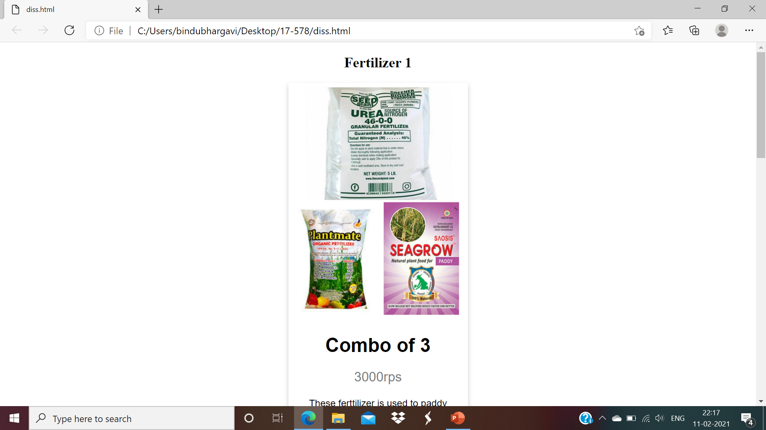
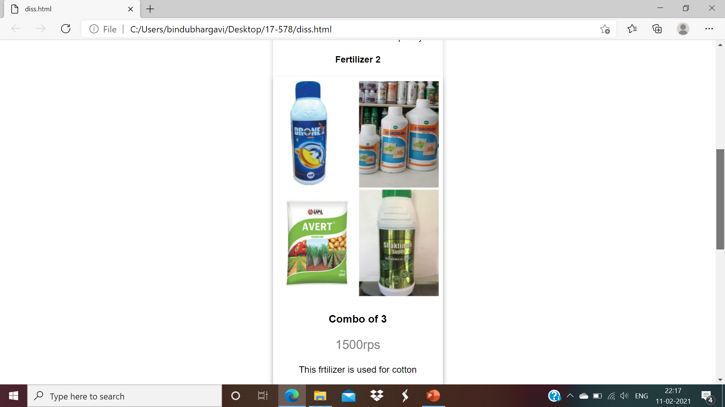
Displaying fertilizers:

Slide 20
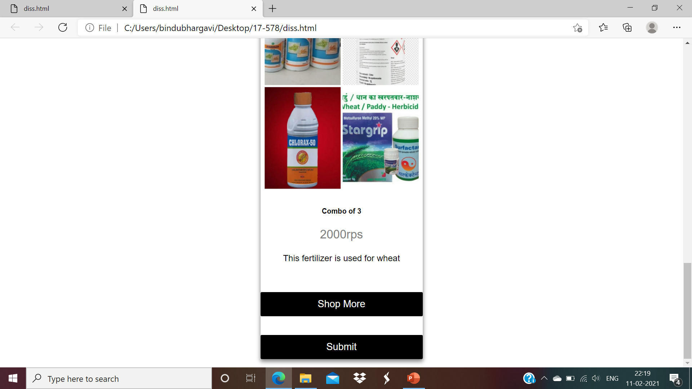

Slide 21
Conclusion:
At the end of this project, we have acquired the result of an accurate fertilizer for particular crop . In comparison to existing modules, this proposed module is prevent from getting cheated and more helpful for cultivation group . this application can give accurate information regarding fertilizers .

Slide 22


